Slide 1
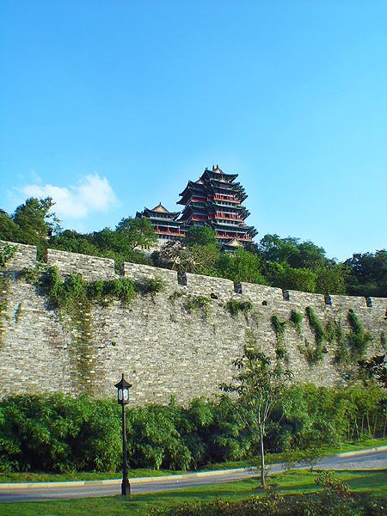
Ming Dynasty (1368-1644)
明
代

Slide 2
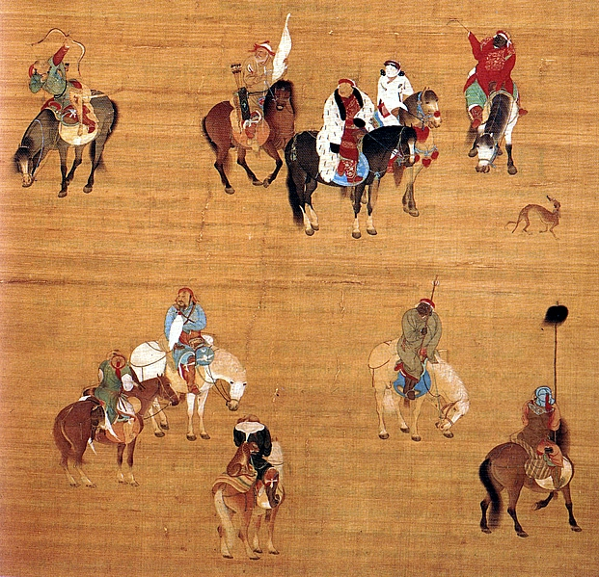
Decline of the Yuan
A. After Khubilai Khan, seven emperors came to the throne and were deposed in bloody struggles; court divided in factionalism; even after an emperor died, his royal household continued to exist and to be supported by the new court, by the end six courts were in existence, beginning with Khubilai's court.
B. Mongol nobles still lived out on the steppe and retained their own standing armies, later Yuan emperor became puppets of one or another cliques of nobles.

Slide 3

Natural Disaster and Internal Collapse
With the 1344 flooding of the Yellow River, crews of conscripts gathered to work on the dikes. 150,000 men and 20,000 troops were enlisted.
From these crews came the rebels that challenged Mongol rule. Open rebellion in 1352.

Slide 4
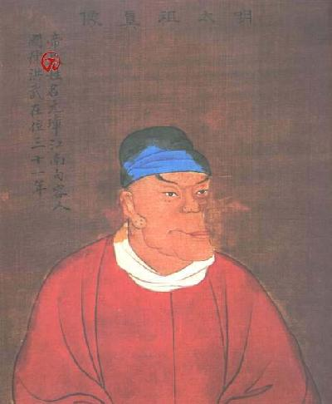
Zhu Yuanzhang 朱元璋 (1328-98)
Born into an extremely poor family and novice in a Buddhist temple. Became a beggar and drawn into the Red Turban Army 紅巾軍 of the White Lotus Society, a secret society where he became a military leader. Zhu later stopped targeting local landlords, instead enlisting their help.

Slide 5
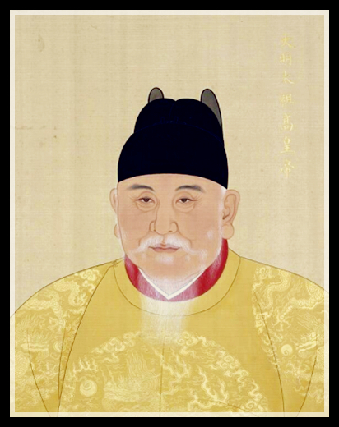
Zhu as Ming Founder, or Ming Taizu
In 1368, against some Chinese support for the Yuan, Zhu had founded his own dynasty, the Ming. Early in his reign Ming Taizu outlawed unorthodox religious sects, including the White Lotus.

Slide 6
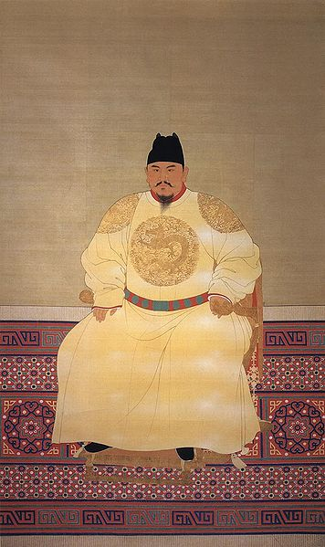
"Superman" as emperor, who learned “Mongol” lessons.
Holding court three times a day, he was demanding of his officials and of his own person.
Ming Taizu believed that he was setting precedents for all following emperors.
As Charles Hucker wrote, “ more than another single person, he was responsible for the style and tone of life that characterized China into modern times (p. 287).”

Slide 7
Ming Taizu’s Policies
1. The royal family could not take jobs; this policy would cause problems in later generations. 2. Ming Taizu served the underprivileged; confiscated large estates, the state’s-own land was rented out to landless peasants. 3. Total number of eunuchs limited to 100; any eunuch who participated in politics would be executed; Ming Taizu would violate this order during his own lifetime; numbers of eunuchs steadily increased; eunuchs set up their own policing system and thereby gained immense power. 4. Ming Taizu reformed the law code; decreed that his own code the Huang Ming Zu Xun 皇明祖訓 (Admonitions of the Ancestors) must be kept in every household; punishments for crimes would be made lighter if there was evidence that the violator possessed a copy of the Zu Xun. 4. Ming Taizu's ruthlessness had a method; he was trying to create the ideal Neo-Confucian man.

Slide 8
Effect of Ming Taizu’s Legacy on Ming Leadership
1. Emperors acted as military leaders; not always successful: The Tumu Incident 土木之變(1449)
a. Emperor Yingzong 英宗(1436-1450, 57-65) led a campaign against the Mongols (now located to the northwest of the Chinese empire) and was captured!
b. Mongols believed that they were in a great bargaining position, but the Chinese court didn't want to bargain and instead chose a new emperor.
c. Yingzong was held for one year and finally sent back to Beijing. New emperor put Yingzong under house arrest. Five years later Yingzong staged a coup and drove new emperor from the throne.
2. Later Ming emperors felt burdened with Ming Taizu "workaholic" image.

Slide 9
Ming Institutions
1. The Censorate:
a. It was the eyes and ears of the emperor
b. This institution placed a check on the whole of the bureaucracy.
c. The institution enhanced imperial power; shaped dictatorial role of the emperor.
2. The Grand Secretariat (1382) as the emperor's personal advisors.
a. Prime Minister (Chancellor) Hu Weiyong 胡惟庸 was accused of treason in 1380, extended family and associates were executed (totaling more than 40,000 persons!) and his position abolished; Ming Taizu needed someone to help with his paperwork (basically secretaries!).
b. Emperor Xuanzong 宣宗(1398-1435) relied even more heavily on the Grand Secretariat and increased their power.

Slide 10
Ming Institutions (cont.)
3. Examination system established quotas for the each province
a. Exams served national integration.
b. Quotas checked the power of candidates from the Lower Yangzi Valley region; kept this group from dominating the bureaucracy.
c. Ming Taizu approved of the literary form, the "eight-legged essay" and this style became the standard for the examination system until the abolition of the system in 1905.
4. Development of the li jia 里甲 system; ten families to a li, ten li to a jia; had to post the occupations of their members; responsible for each other's conduct.

Slide 11
